Slide 1
Coptic Lesson 22 possessive ARTICLE "of"

Slide 2
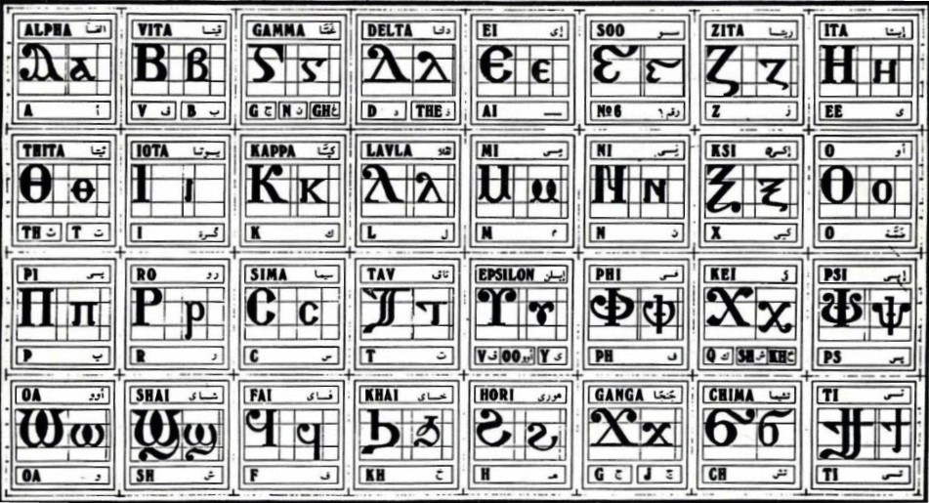
Coptic Alphabets

Slide 3
Review Questions
Coptic
Name
English
Pen¡
pen[oic
Our Lord
==p=n=a
`pneuma
Spirit
=c=w=r
cwtyr
Savior
=n=;
tebi-'it
59
=o=z
`sbe-sasf
77
P=,=c
Pi`,rictoc
The Christ
=o=b
`sbe-`cnau
72

Slide 4
Rule for the Kei <:
k
(in a Coptic Word)
< , =
sh
(Gk, before the e-family)
e-family:
e> y> i> u
kh
(Gk, otherwise)
Examples:
,ymi
,aric
,ere
`,rwm
Ar,y
Mona,oc
,w
Lu,nia
Pi,iwn
,wra
Ic,uroc

Slide 5
Vocabulary List
`e
to, for, toward
nem
and, with
menre
to love
se
to go
nyb
Lord, lady
of
`nte
seri
daughter

Slide 6
Beginner Vocabulary Review
romi kahi `Vnou] `alou ioh
ry con syri iwt bal
yi ran ro ouro nyb
`chimi vorsi seri ourw ri
cwni ajp ve sau soury
mau ]`alou jij `;nyb hiomi
nicwni nirwmi niran nimau ni`alou
jom niourw nibal nisau ninyb
niseri totc io] ourwou vyou`i

Slide 7
Possessive Article
Possessive "of " is formed by:
Using the preposition `nte
Adding `n (`m) to the object as a prefix
`n become `m if the word begins with
b, m, p, ', v, f

Slide 8
Possessive Article Examples
Translate the following:
`pkahi `nI=l=y==m
the land of Jerusalem
]jom `nte V]
the power of God
`pyi `nte niaggeloc
the house of the angels
Nisyri `nte piouwini
the sons of light
`P[oic `nte nijom
The Lord of powers
`m`viwt
of the father
`mPi=c=l
of Israel
`nI=l=y=m
of Jerusalem
Qen `vran `m`Viwt
In the Name of the Father

Slide 9
Announcement
All slides are available at http://www.ekladious.com/coptic.html

Slide 10
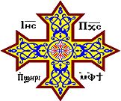
Oujai qen `P[oic

